Slide 1


Centro de Excelência em Redes Inteligentes Sem Fio e Serviços Avançados

Slide 2
Joint Communication and Sensing (JCAS)
Grupo/Eixo Temático: Pesquisas em 6G
Participante:
Coordenador do Grupo: Rodrigo Pinto
Data: 30/01/2024

Slide 3
Sumário
Visão Geral
P&D -> PDI
Network beyond communications
Joint Communications & Sensing
Planejamento

Slide 4
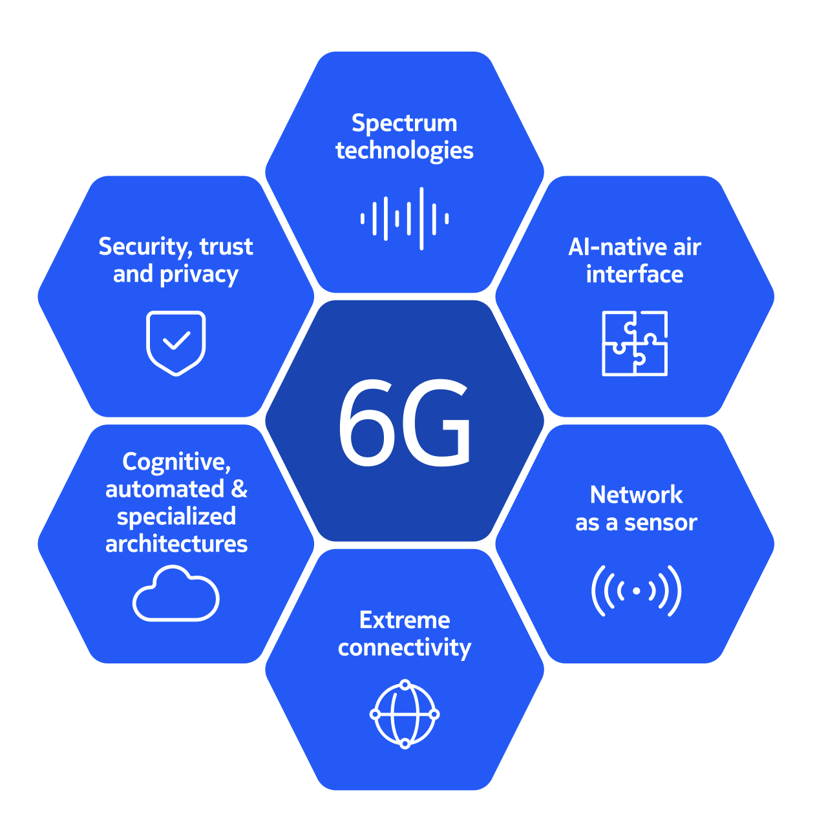
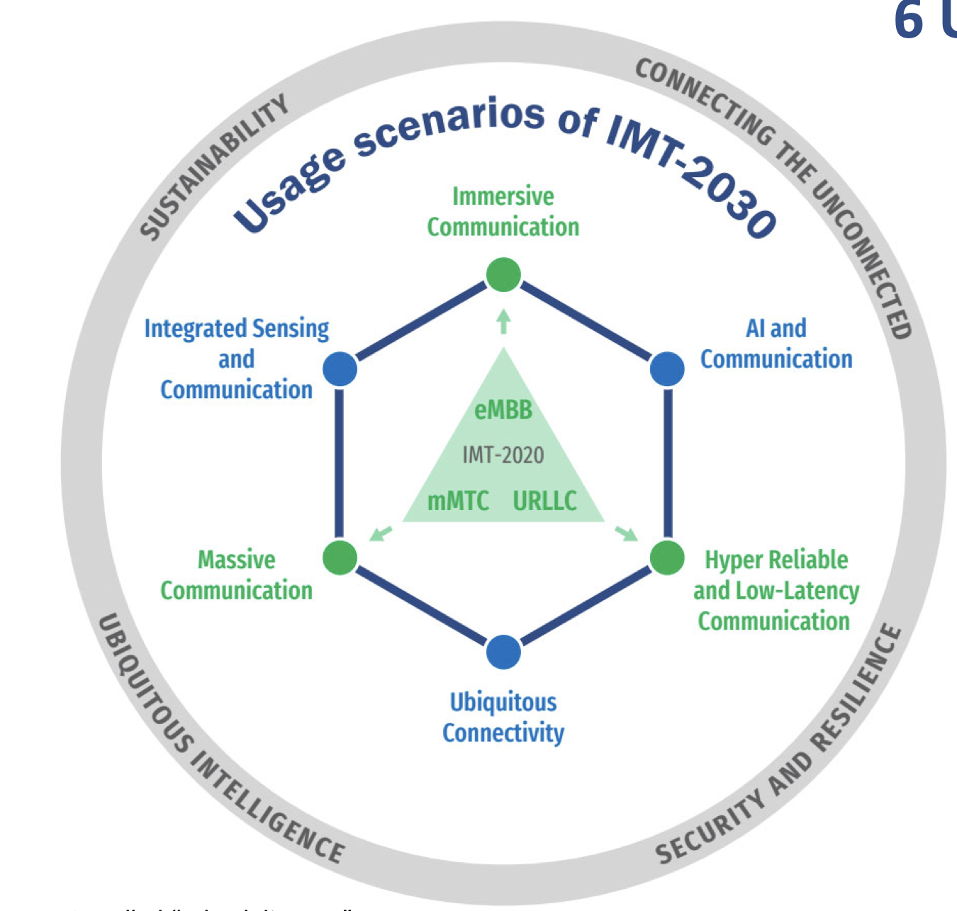
6G Network Overview

Slide 5
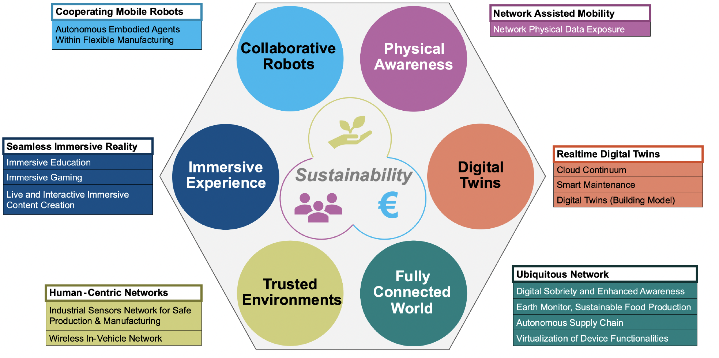
6G Network Overview
Hexa-X-II Use Case Families

Slide 6
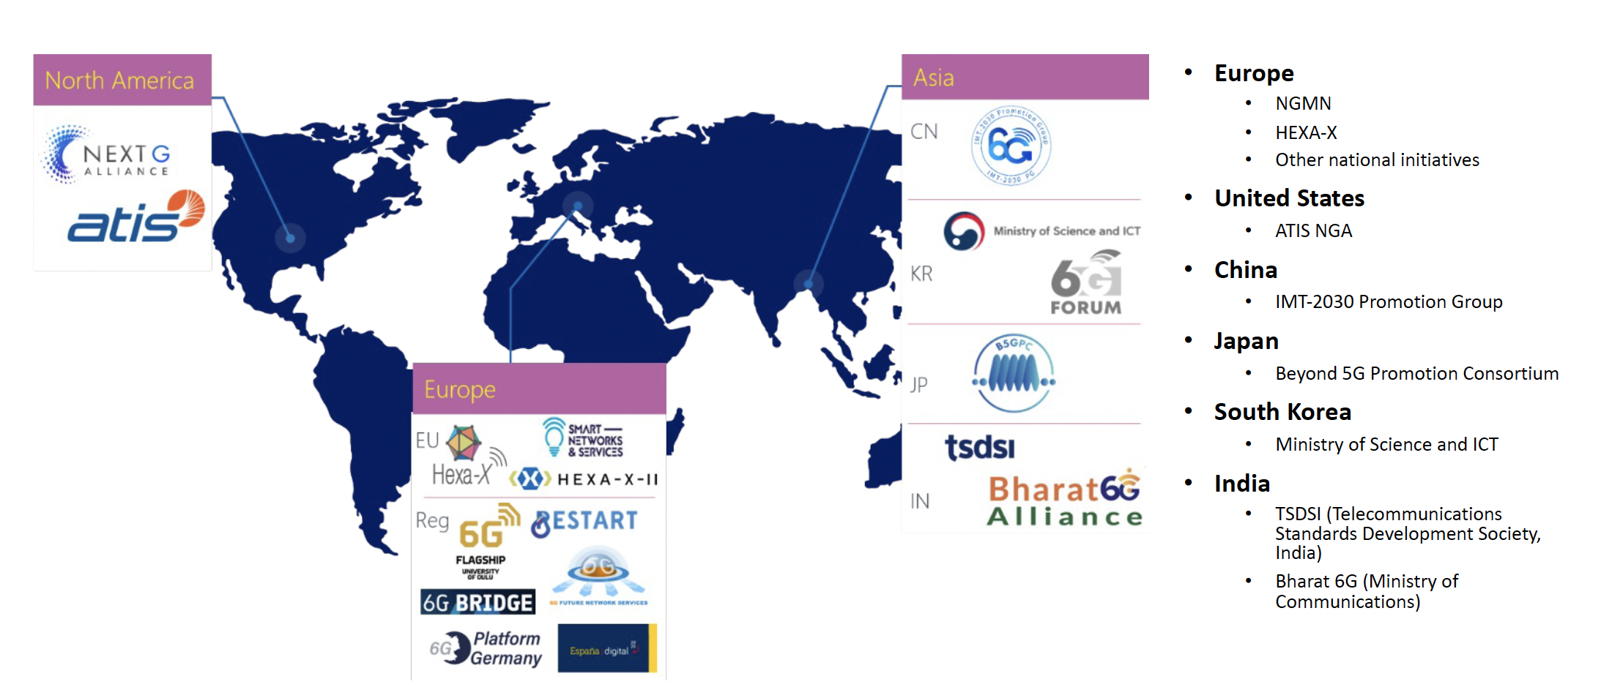
6G Network Overview
Key worldwide initiatives

Slide 7
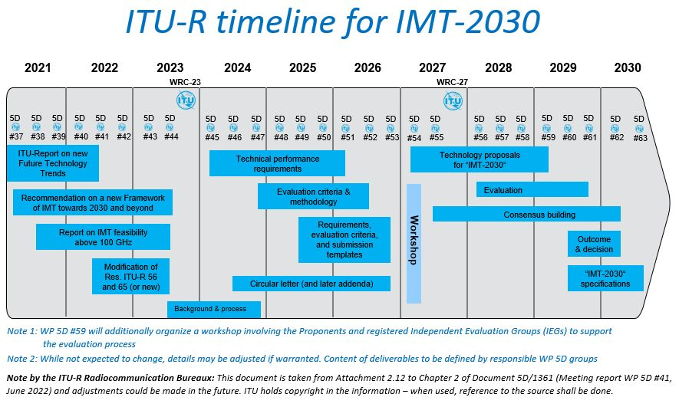
6G Network Overview

Slide 8
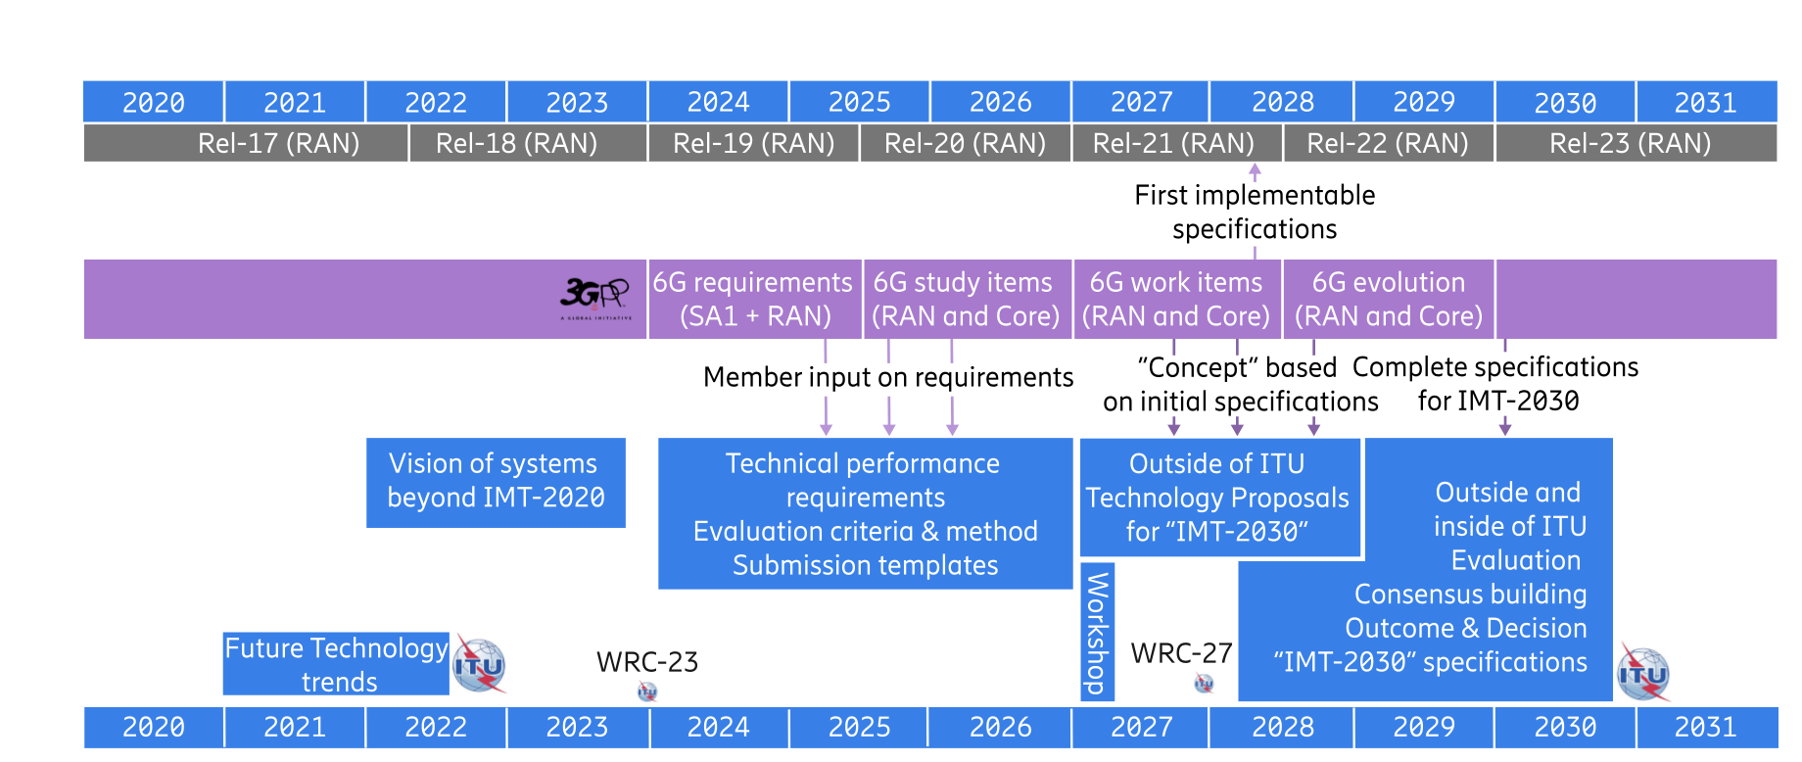
6G Network Overview

Slide 9
CERISE P&D para P&DI
Induzir nova direção
Direcionando os esforços
Pesquisa que gera oportunidades de inovação
Business
Hardware
Startups
Future products
RH
Software
P&DI
P&D
Optimization E2E
P&DI
Prototype
WPs
Link Level Simulations
Use Cases/scenarios
System Level Simulations
network
Concepts
Protocols
IPR/Publications
Standard Contributions

Slide 10
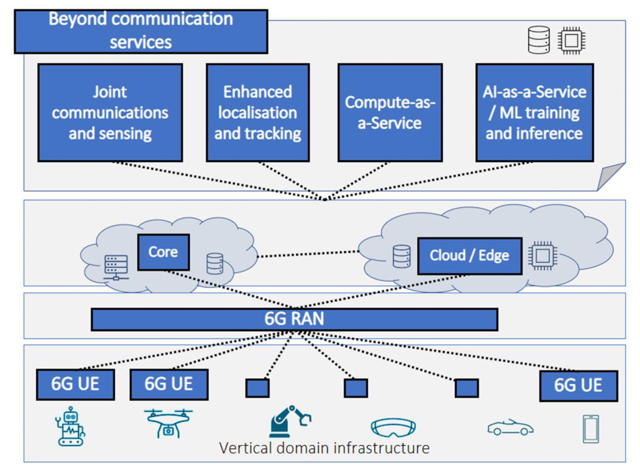
6G Network Network Beyond Communication
Communications: primary objective of wireless and mobile networks up to 5G
IoT and Edge Computing -> extending the network scope and capabilities beyond communications
Connectivity was still the primary target
6G Network: beyond conventional connectivity into accommodating and supporting novel services
Delivering added value from societal, innovation, and business perspectives

Slide 11
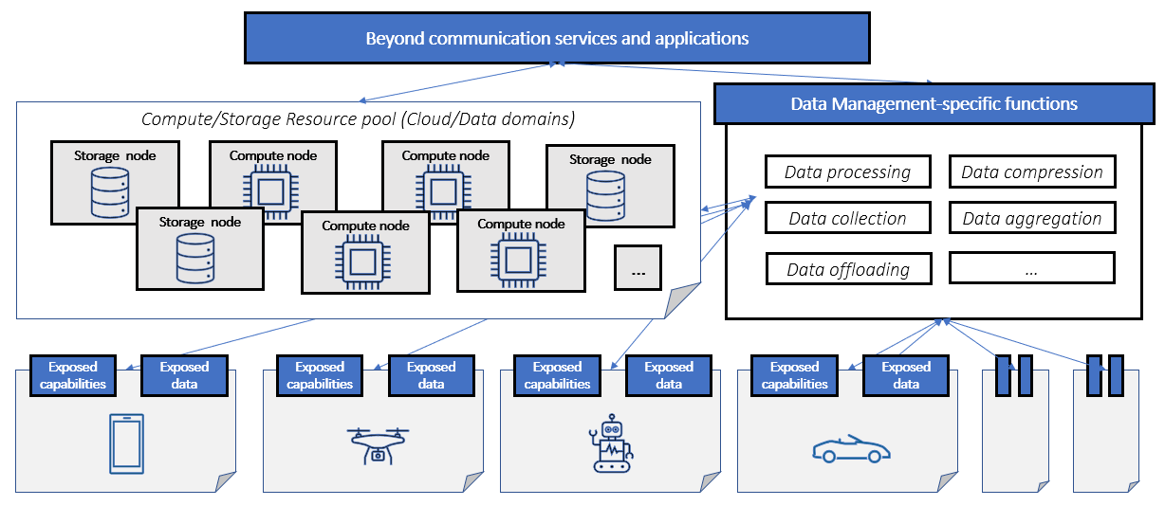
Network Beyond Communication Data management
New applications : require advanced data management capabilities
New devices: diverse capabilities and provided data
Requirements: flexible and scalable data management solutions able to handle massive amounts of data
Seamless user experience
Convergence of communication and computing

Slide 12
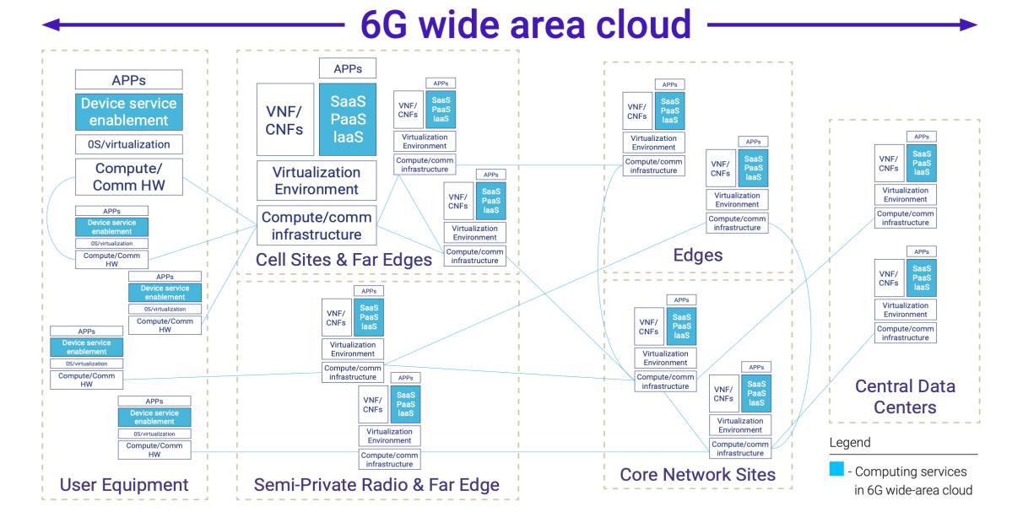
Network Beyond Communication Protocols, signalling and procedures for BCS
Discovery of the compute
Synchronization and coordination among offloading and computing nodes
The coordination of communication and computation resources within the network
The impact of new sensing services on RAN inerfaces and functionality.
Convergence of communication and computing require news protocols, signaling and procedures

Slide 13
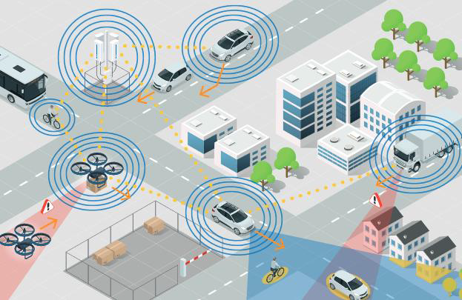
Network Beyond Communication JCAS
The inclusion of sensing capabilities in a wireless communication networks
many new use cases (e.g., Human Localization and Tracing, SLAM, 3D vison)
JCAS as the main 6G enabler

Slide 14
JCAS Terminology
Positioning
Estimation: position of the connected device
Positioning may rely on sensing information.
Localization
Includes also the estimation of the position of a passive object/target
Sensing comprises
Receiving a set of radio signals and processing these radio signals to extract information relevant for a service.
The received radio signals in general depend on the geometric state of the transmitter, receiver, and the environment
JCAS
Wireless systems that combines communication and sensing functionalities to reuse hardware, save resources (vs. having 2 systems), and/or for across-functional benefit.

Slide 15
JCAS Research: unified radio infrastructure
Architectures
Waveforms, frame structures & Resource allocation
Security & Privavacy (not in the scope)

Slide 16
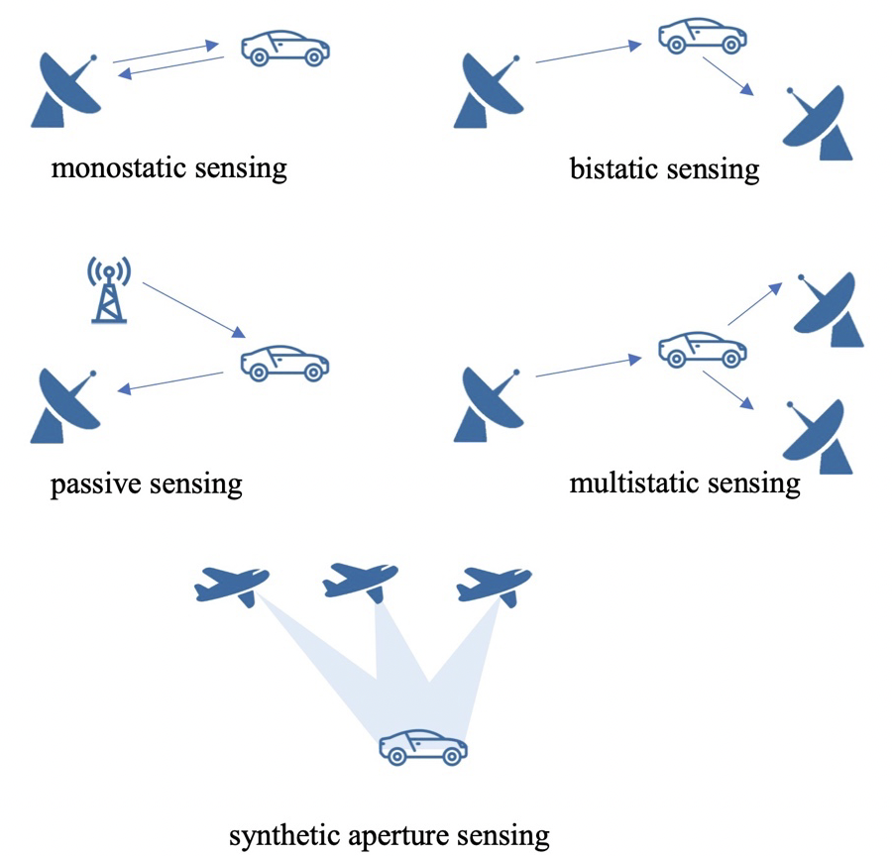
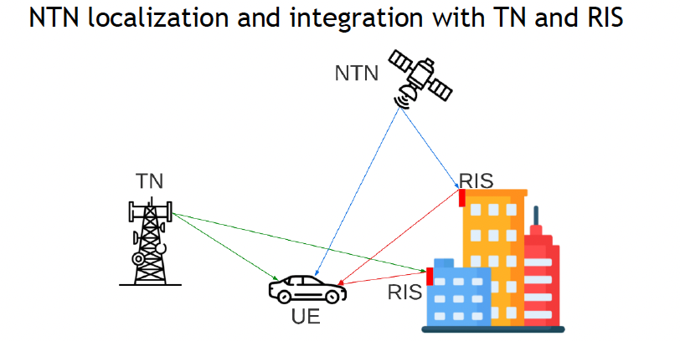
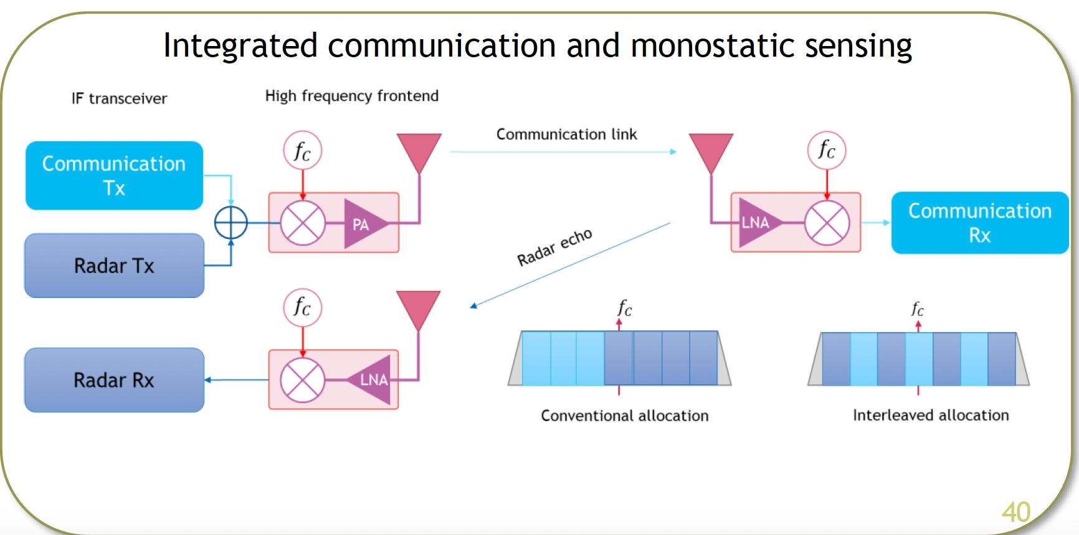
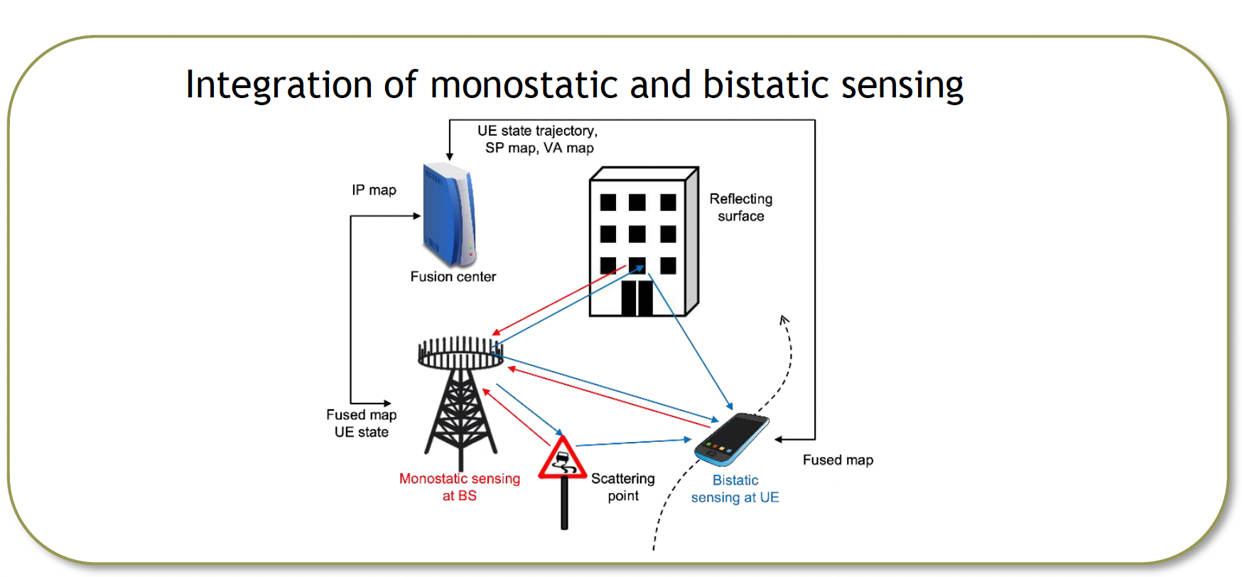
JCAS Research: unified radio infrastructure
Architectures
Investigating multiple sensing and localization deployment scenarios to provide a positioning/sensing solution
NTN-aided localization
Integrated communication and monostatic sensing
Integrated monostatic and bistatic sensing
Multi-static sensing

Slide 17
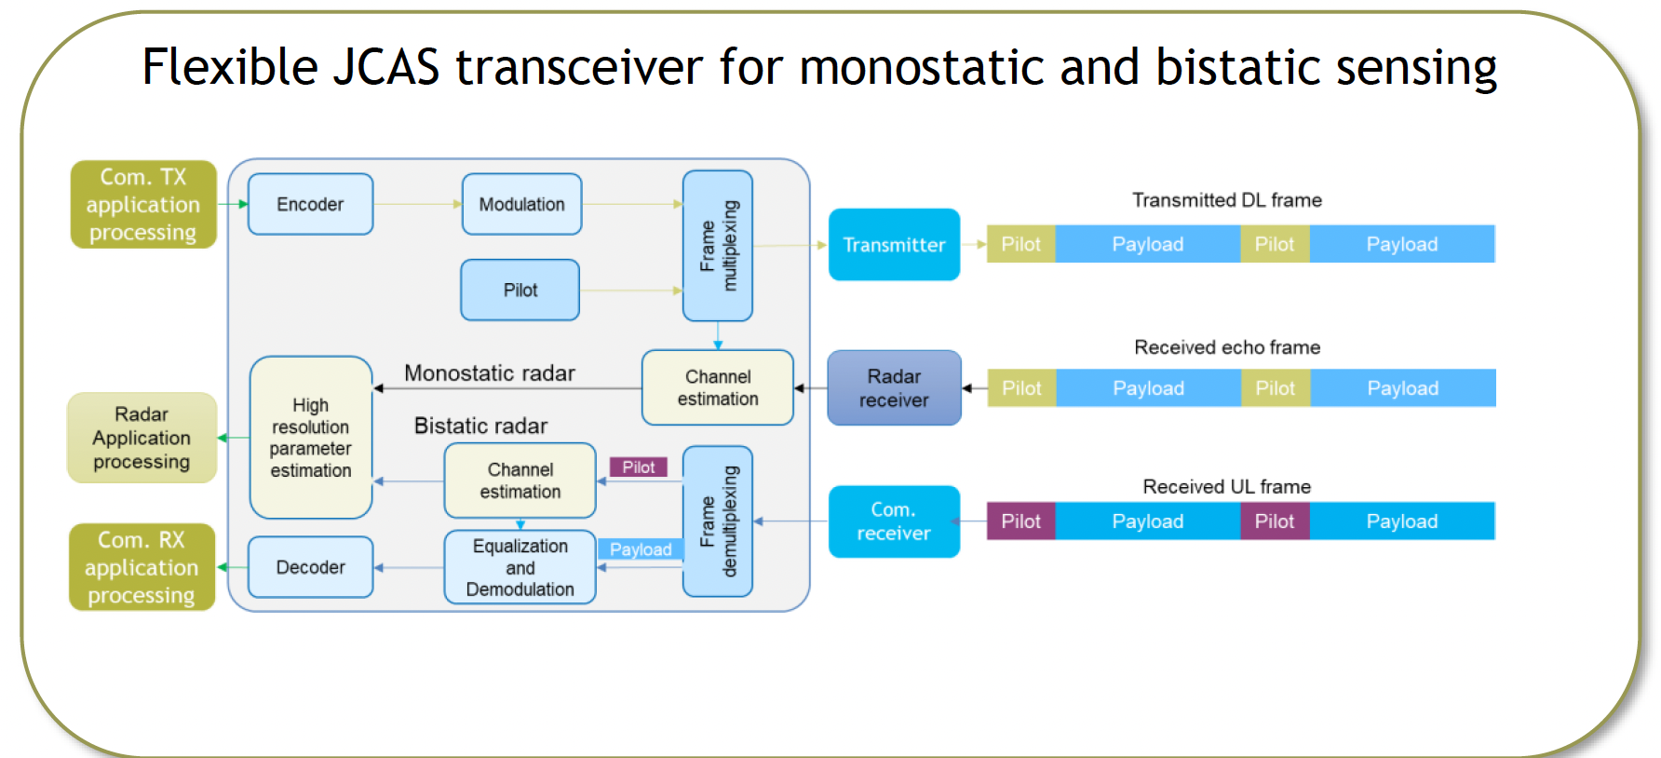
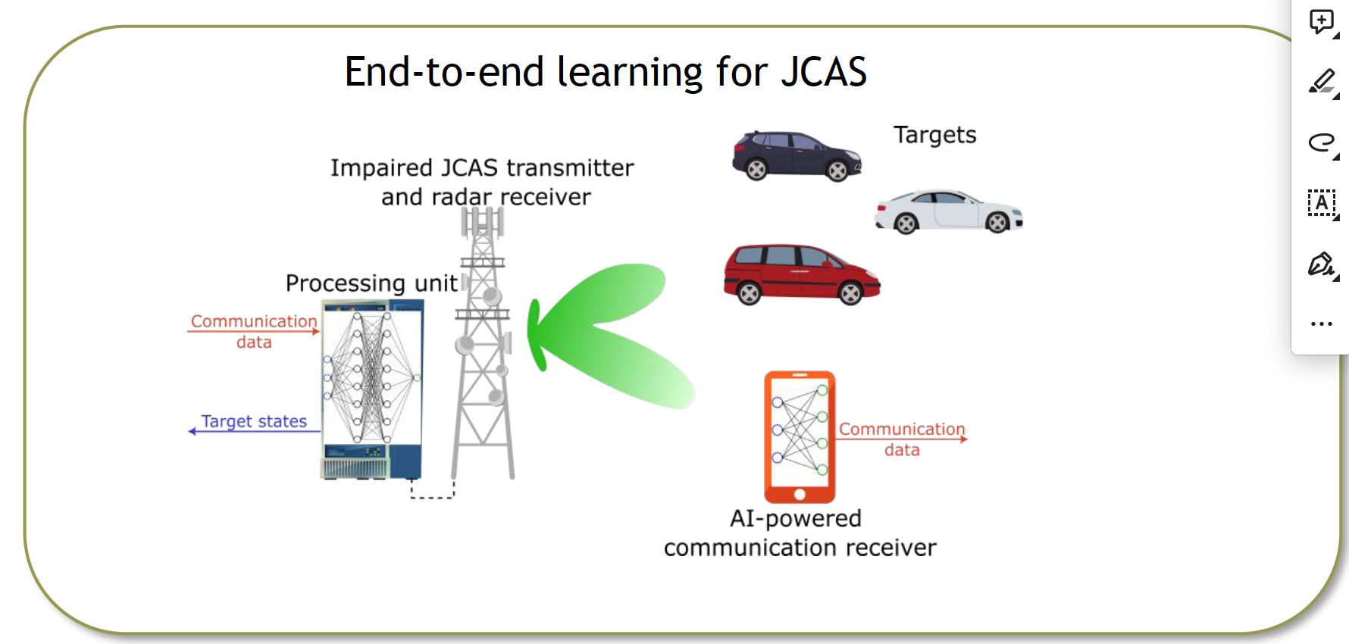
JCAS Research: unified radio infrastructure
Waveforms, frame structures & Resource allocation
Investigating methods to re/co-use communications infrastructure (waveforms and frames) for sensing and localization purposes
Flexible baseband transceiver for JCAS
Waveform learning for JCAS
Optimization of OFDM-based bistatic sensing

Slide 18
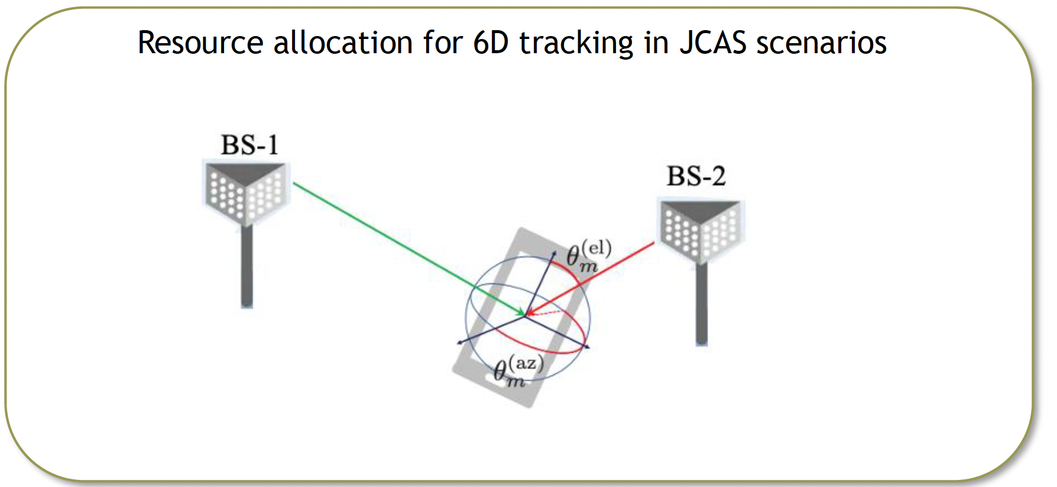
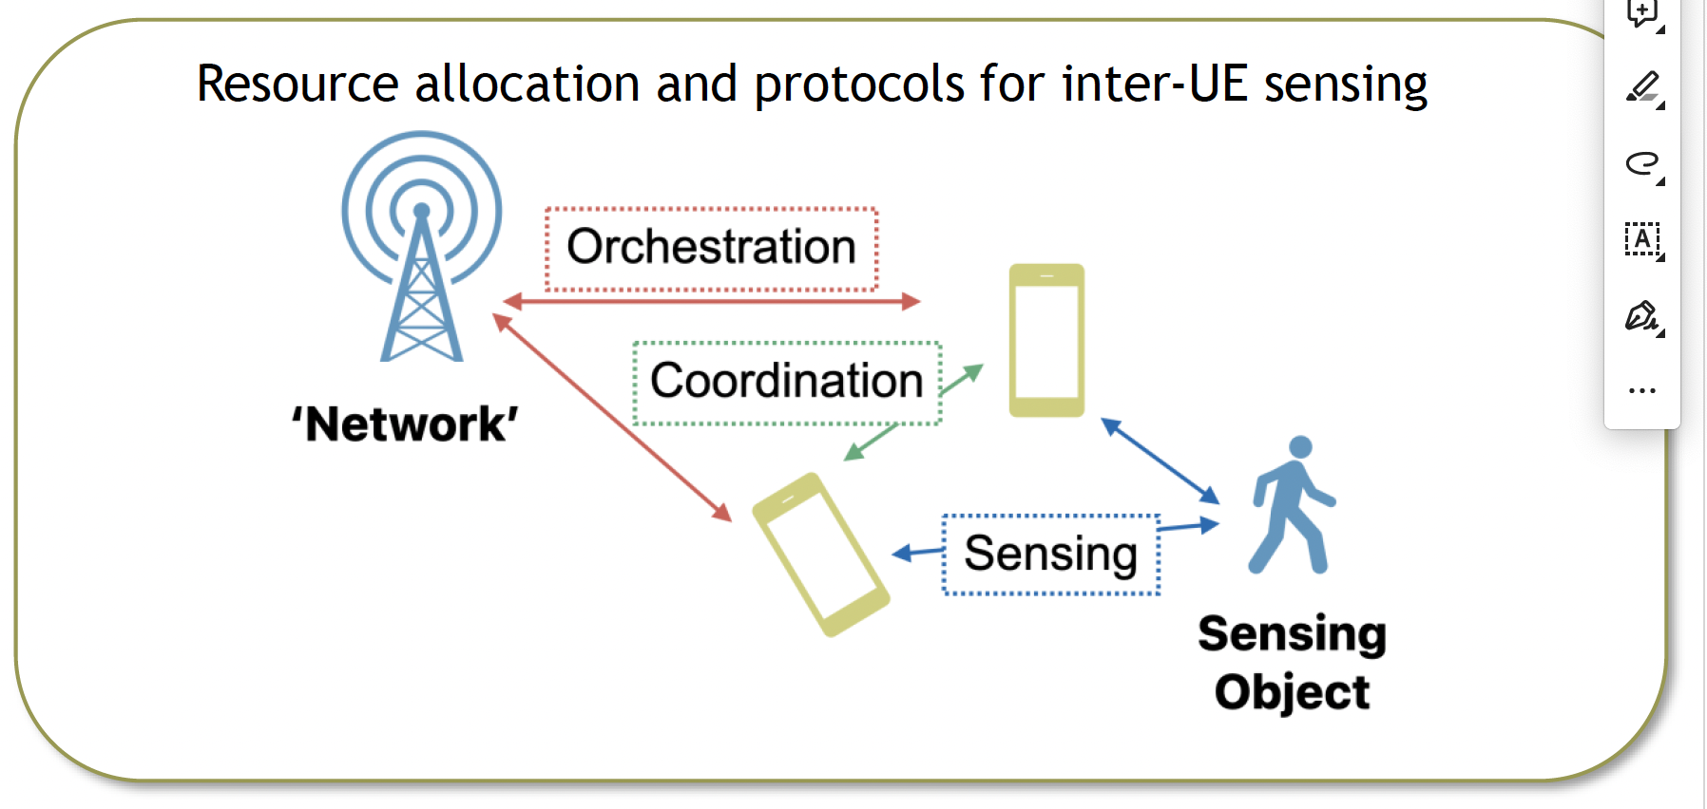
JCAS Research: unified radio infrastructure
Waveforms, frame structures & Resource allocation
Optimal precoding and resource allocation through model-based and data-driven techniques
Multiband hybrid-beamforming transceiver
6D tracking in JCAS scenarios
Inter-UE sensing

Slide 19
JCAS Research: unified radio infrastructure
Integration of quantum communication-sensing for enhancing 6G beyond communication capabilities
Indoor mapping using mmWave WiFi C&S

Slide 20
JCAS Planejamento
Fev24
Mar24
Abril24
Maio24
Junho24
Jul24
Agos24
Set24
Out24
Nov24
Dez24
Jan25
Revisão Bibliográfica
Simulação Computacional: definição da ferramenta, implementações e simulações
Desenvolvimento de soluções/protótipos
Avaliação de Cenários (Estudos de Caso) e de Propostas
Escrita de Relatório (Semestral)/Artigo
Orientação de alunos de Iniciação Científica, Mestrado e de Doutorado

